Slide 1
Visualizing Country Music
Exploring Country Music’s Changes since its “Golden Era” Using the Spotify API

Slide 2
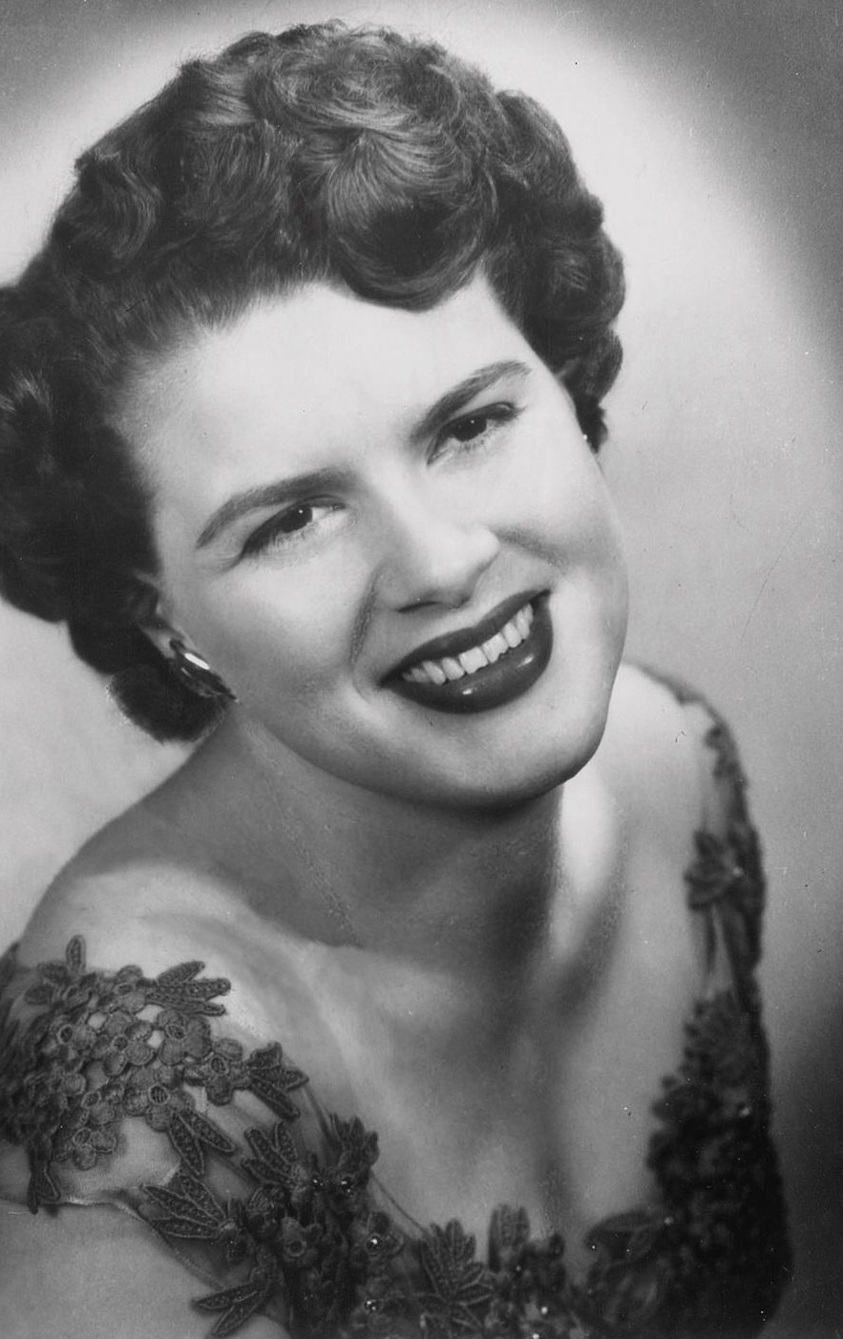
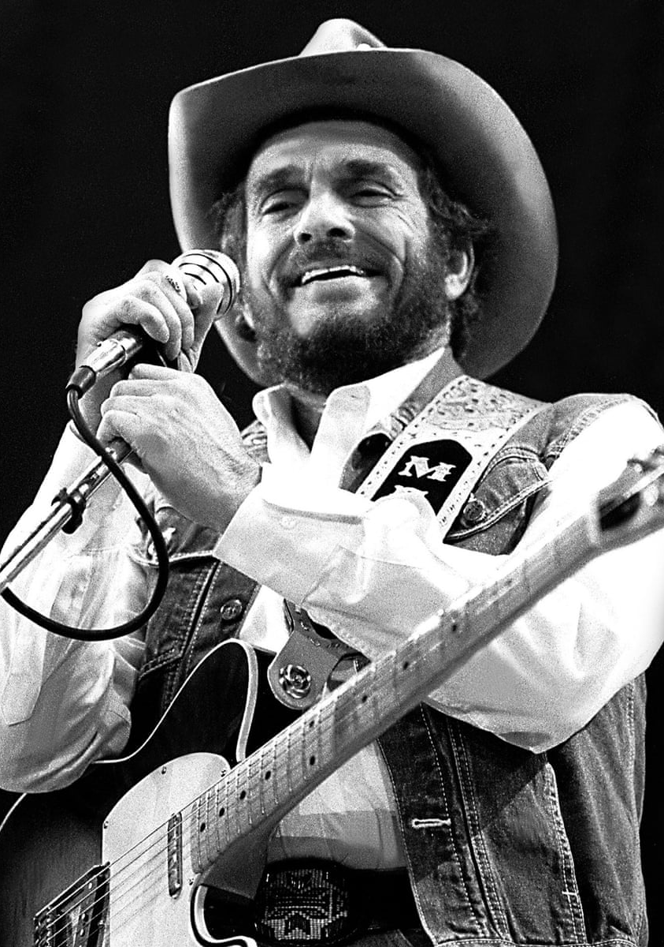
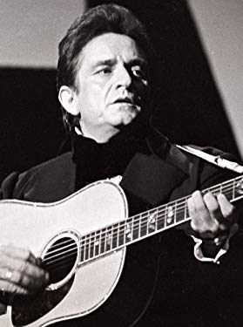
The Question:
How has country music progressed since its heyday to now?

Slide 3

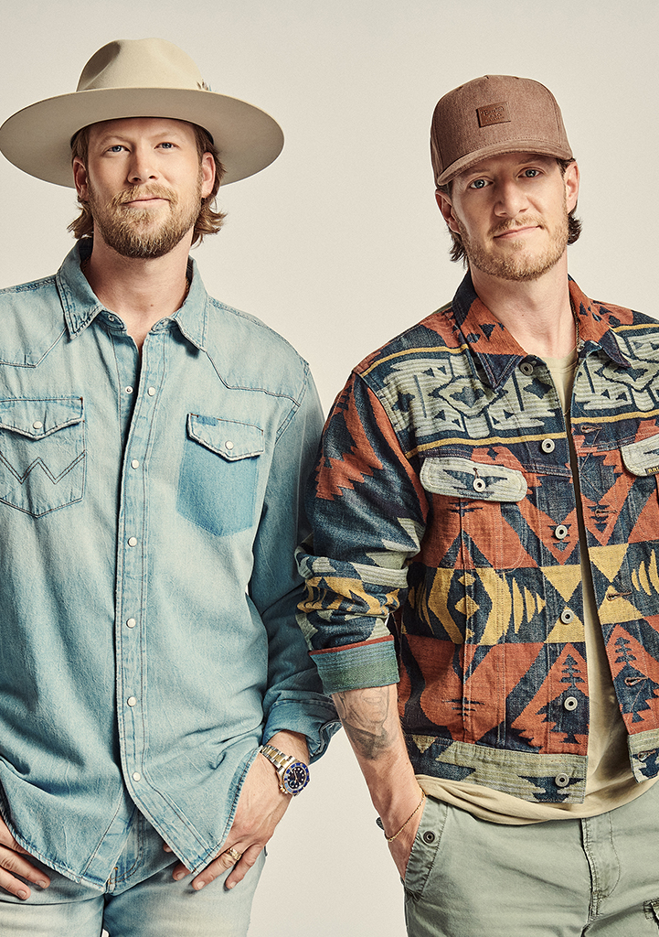

The Question
How does the progression of country music compare to pop music?

Slide 4

The Method
Through the usage of Spotify’s API and Python, information about every song, artist, playlist, and more can be accessed.

Slide 5
The Metrics
Acousticness: A measure from 0 to 1 determining presence and magnitude of acoustic elements
Danceability: Indicator from 0 to 1 determining how suitable a track is for dancing based on a combination of musical elements including tempo, rhythm stability, beat strength, and overall regularity.
Energy: Measure from 0 to 1 range describing perceptual intensity and interactivity of a song
Loudness: Decibel level averaged through entire track and usually between -60 and 0 db
Speechiness: Detects the presence of spoken words in a track with 0 being few words and 1 being wordier (rap, audiobooks, etc.)
Tempo: Estimated tempo of a track in beats-per-minute (bpm)
Valence: Musical positivity conveyed by a track from 0 to 1

Slide 6
The Challenges
1.) Querying Spotify’s API with the correct credentials to get the proper data.
2.) Determining what kind of data is needed.
3.) Working the data into a useable format.
4.) Informatively depicting takeaways.

Slide 7
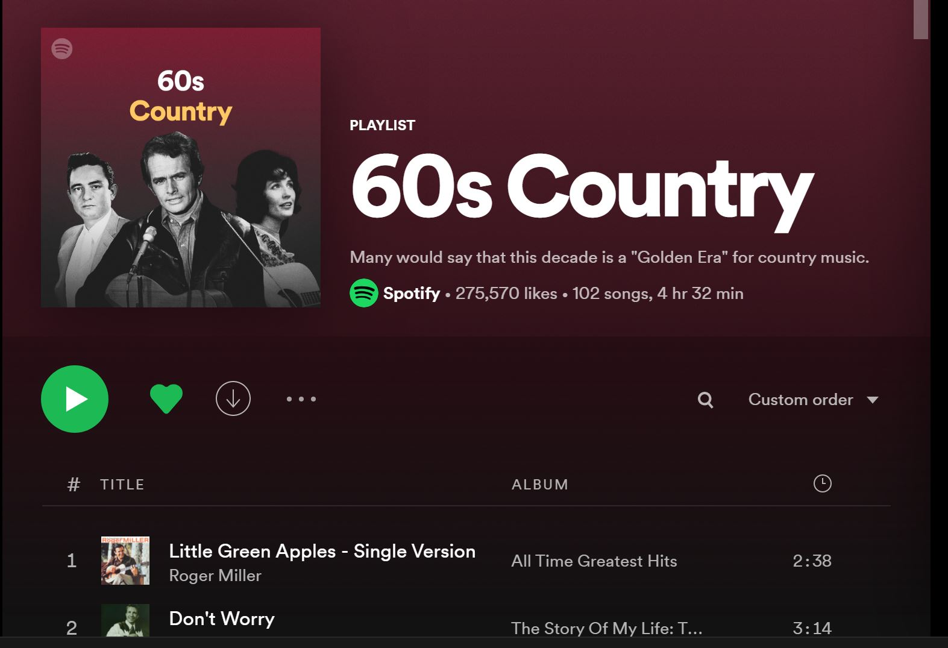
The Data
Spotify-created playlists
Dave’s Music Database: Rankings are figured by combining sales figures, chart data, radio airplay, video airplay, streaming figures, awards, and appearances on best-of lists.
Billboard year-end charts

Slide 8
The Dashboard
https://app.powerbi.com/groups/me/reports/e550b1f1-b461-44c1-9b00-39f2cc505563/ReportSection

Slide 9
Honorable Mentions

